Slide 1
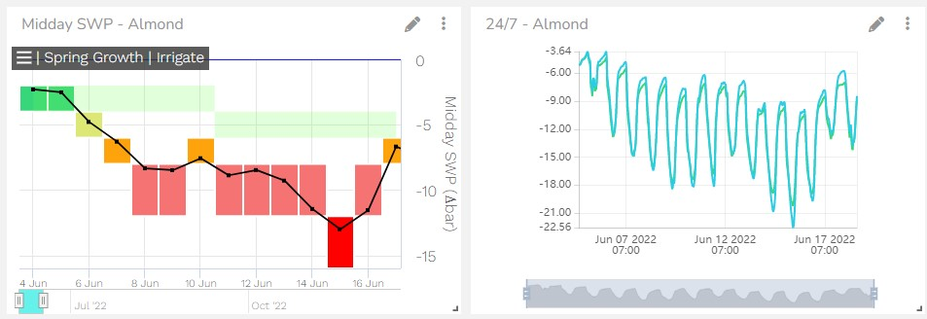
Davis, CA USA admin@florapulse.com +1 (530) 220-7668 www.florapulse.com
FloraPulse Microtensiometer
The FloraPulse microtensiometer is a plant-based water potential sensor developed at Cornell University. It is a microchip tensiometer, implanted inside the plant xylem that directly measures stem water potential (SWP) for a full growing season or longer, without maintenance. The first truly set and forget water potential sensor. Designed for growers, the sensor is reliable and easy to install.
Data visualization as shown in the FloraPulse App. Data is visualized as Midday SWP (left) and continuous 24/7 SWP (right).
Directly measure water potential in many crops, for growers and scientists
The FloraPulse system is useful for growers and scientists. The sensor is approved for use in many woody crops including: Almonds, Cherry, Grapes, Mango, Olive, Hazelnut, Apples, Prunes, Pistachio, Peaches, and more. It has been validated to provide very similar measurements to the Scholander pressure chamber.
The sensor has a measurement range of 0 to -3.5 MPa. Installation takes less than 20 minutes. FloraPulse sells individual sensors in analog and SDI12 versions, and an all-inclusive subscription that includes telemetry and online data visualization.
Applications
Our systems give commercial orchards and vineyards direct, continuous SWP data to irrigate according to the needs of their crop. We help them increase produce yields, quality, health and water use efficiency.
FloraPulse is also used by scientists worldwide to better understand water stress in validated and new crops, and the plant response to irrigation, weather and biotic factors. FloraPulse is the only sensor capable of providing continuous SWP measurement. And it’s all backed by many peer-reviewed publications.
Our Services
FloraPulse sells directly and through distributors in 23 countries and counting! All sensor versions include the microtensiometer probes and tools needed for installation. We have comprehensive manuals, install videos, and other resources available on our website. We will work with you to ensure that the equipment functions reliably, and help you understand how to make the best use of it.
Presented by
FloraPulse distributor in Spain and Portugal.
www.lab-ferrer.com
info@lab-ferrer.com
+34 973 532 110
Bolonia, July 2023

